Slide 1
ScPipeline tutorial
Mikolajewicz et al, 2022.

Slide 2
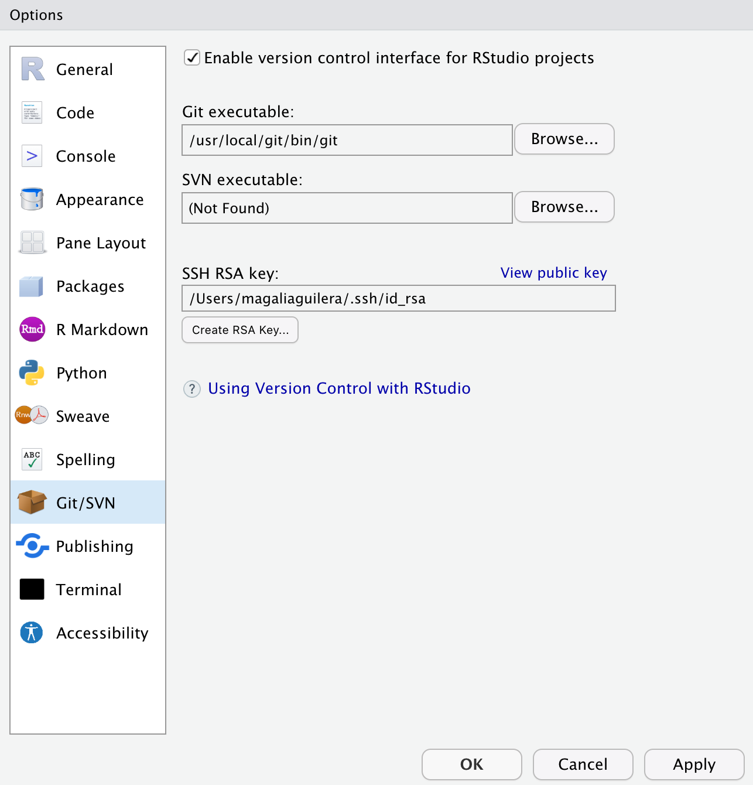
Getting started. Cloning the scPipeline git repository
1. Install git and enable version control interface for RStudio by going to Tools > Global Options > Git/SVN. You will need to add the path to the git folder.
To install git, proceed to the git website and download the latest version. Follow the instructions from the installer and specify or move the git folder once it has been installed.
2. Open RStudio and click on File > New Project. This will prompt you to a window with 3 options. Select “Version Control”.
From there select the “Git” option and add the repository URL (https://github.com/NMikolajewicz/scPipeline) and name (scPipeline). Select a directory for the project.
The available modules can now be accessed from the files under the specified directory.
You may need to restart RStudio to start seeing the changes in configuration.

Slide 3
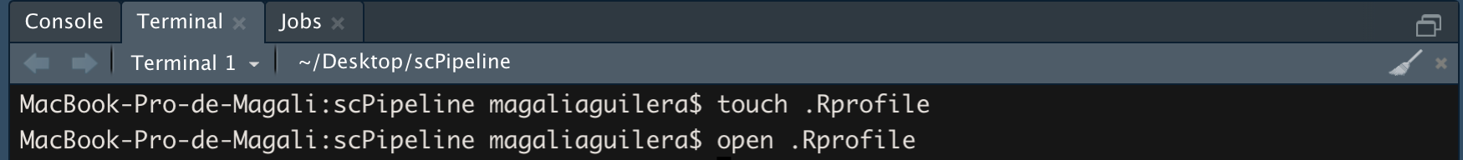
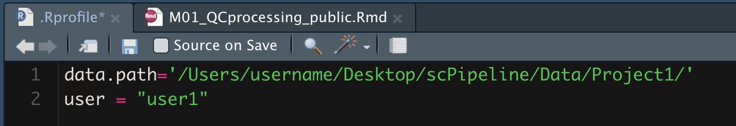
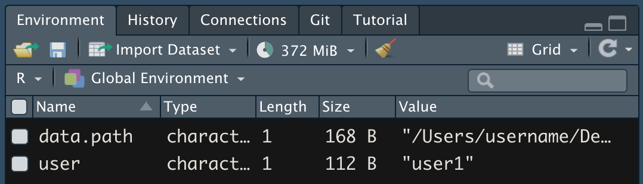
Optional. Set up an .Rprofile with output path and username
3. Optional: To save scPipeline reports and análysis logs to a common directory that is not within the Project folder, users may set .Rprofile file with ”data.path” and “user” for the module log and output path. On the Terminal window type: “touch .Rprofile” and then “open .Rprofile”.
Add one variable per line and then save and close the .Rprofile. “data.path” specifies the directory where scPipeline will save outputs to, and “user” specifies the name of the user.
These variables will be automatically be loading into the Global Environment everytime a scPipeline module is opened. This will ensure that output reports are saved to common directory.

Slide 4
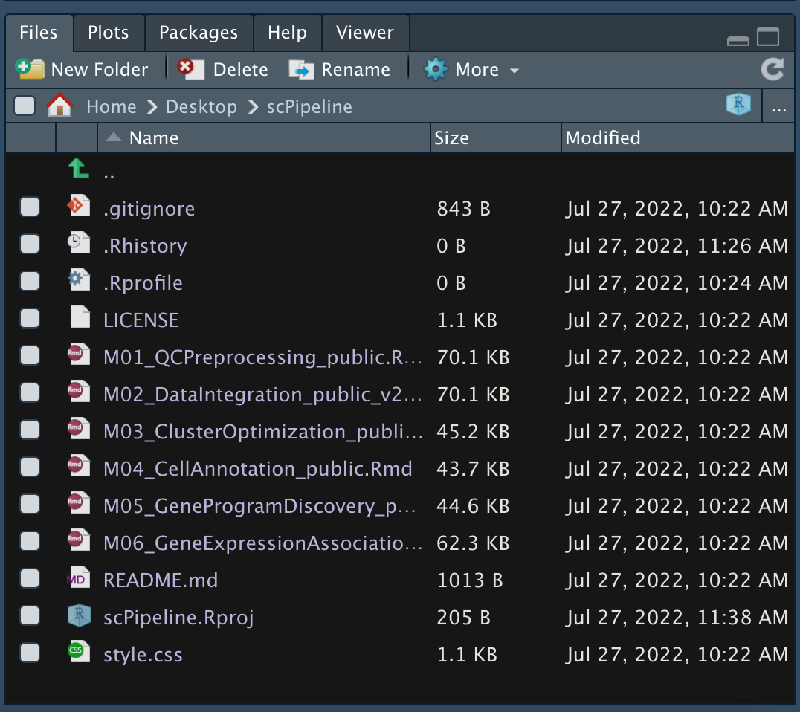
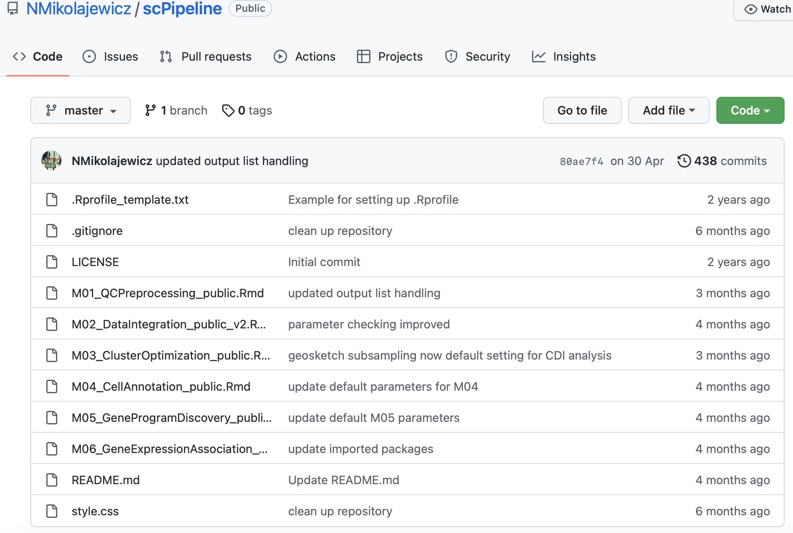
Choosing a module to run
4. Open the scPipeline project with RStudio. To access a module click on the file name under the ”Files” section in the RStudio window.
Alternatively, the code for individual modules can be copied or downloaded from: https://github.com/NMikolajewicz/scPipeline
If proceeding with this alternative option, steps 1-3 may be omitted. However, a .Rprofile can still be created (step 3) to specify the output path and user.

Slide 5
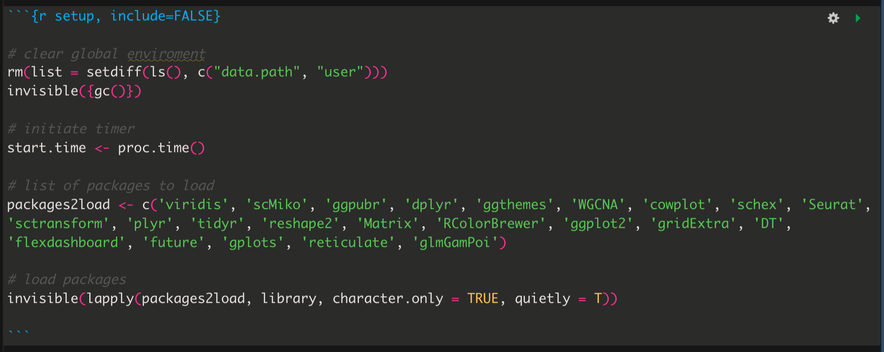
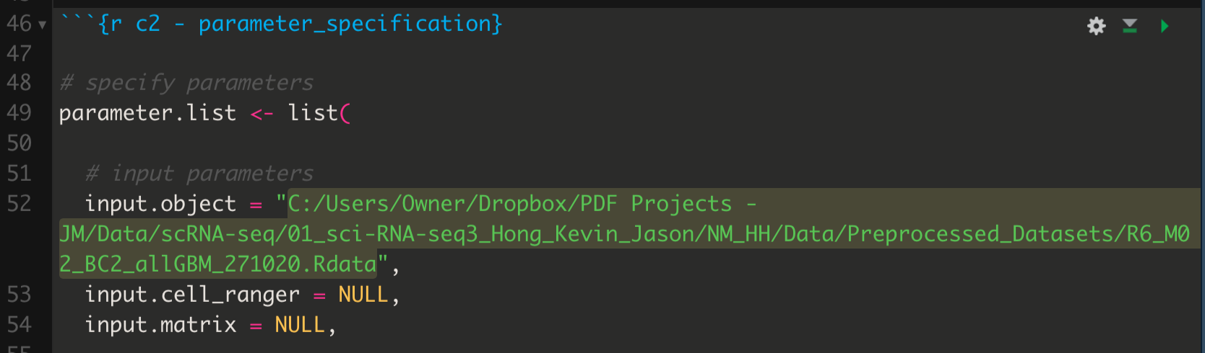
Install packages and specify input parameters
5. Make sure that all packages needed are installed. These can be found in the setup part, the first chunk of code.
6. Open in RStudio the scPipeline module (i.e., R script) you want to run and scroll down to the parameter specification chunk (chunk 2). Edit the parameter.list variables to costumize the analysis.
These can be installed from the Console window using “install.packages()”, “BiocManager::install()” or by visiting the developer website and following their instructions.
For example, add the path to the data file in “input.object”.
Description of the parameters can be found at: https://nmikolajewicz.github.io/scMiko/articles/scPipeline_module_overview.html

Slide 6
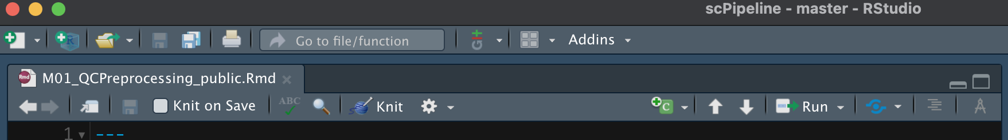
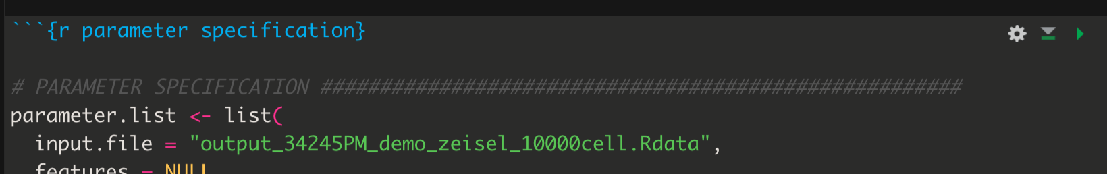
Running a module
7.1 The full module can be run automatically by clicking on the ”Knit” icon. This will run all the chunks sequentially and yield an HTML report which will open in a separate window once the module is done running.
7.2 The module can be run chunk-by-chunk. On each chunk of code click on the green arrow. Set “general.print.inline = T” in “parameter.list” to see the output of each chunk. This option will not generate an HTML report.

Slide 7
Additional Help
Additional documentation for the scPipeline can be found on GitHub: https://nmikolajewicz.github.io/scMiko/articles/scPipeline_module_overview.html
For any additional questions or concerns, please do not hesitate to contact Nicholas Mikolajewicz (n.Mikolajewicz@utoronto.ca)

